Slide 1

01
02
Lecture p-3
04

Slide 2


Today’s Agenda
01
File opening modes in binary mode
02
Drawbacks of file handling in Text mode
03
Importance of file handling in Binary mode
04
Random Input/Output
05
Practical Implementation of ios::binary
05
05

Slide 3

A new Concept
Write a program to write an integer value with value 2147483647 in file message.txt
#include <iostream>
#include <fstream>
using namespace std;
int main()
{
fstream fobj;
fobj.open("f:\\message.txt", ios::out|ios::trunc);
int a = 2147483647;
fobj<<a;
fobj.close();
cout<<"File saved successfully!"<<endl;
return 0;
}

Slide 4
Output of The Previous Code
Output
File saved successfully!
Process returned 0 (0x0) execution time : 0.131 s
Press any key to continue.

Slide 5
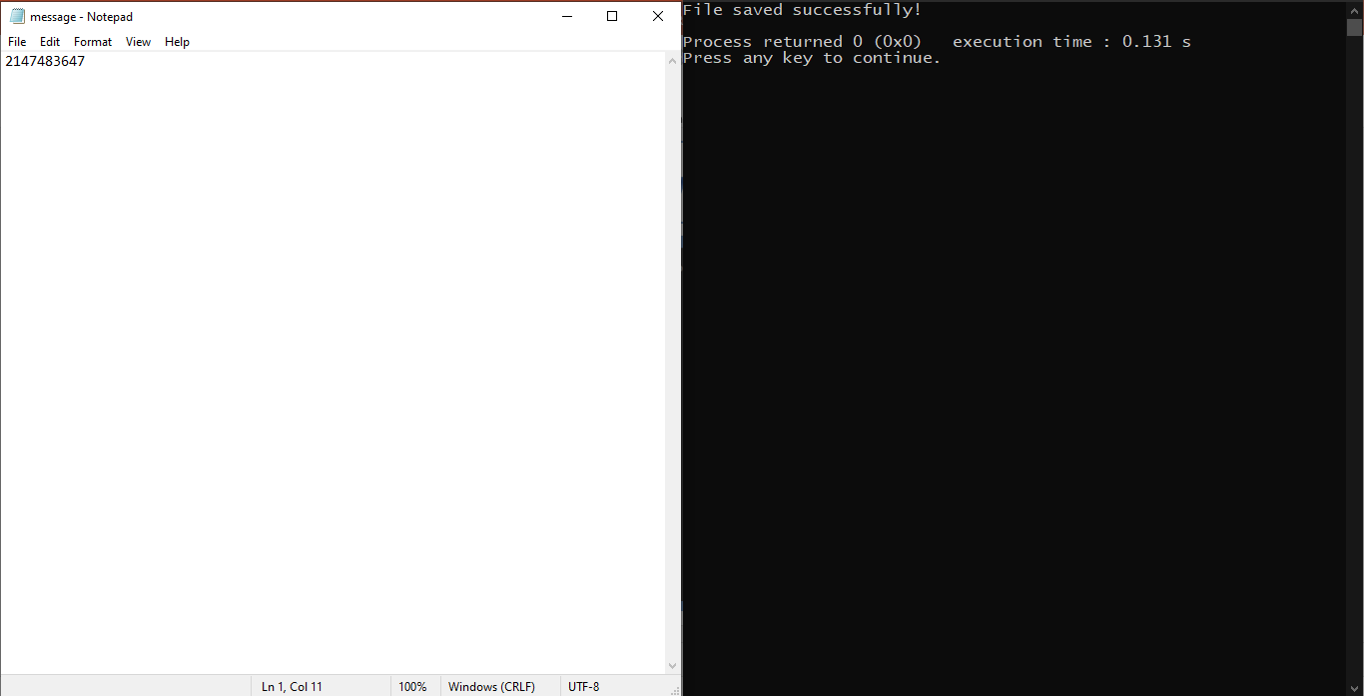
System Screenshot

Slide 6
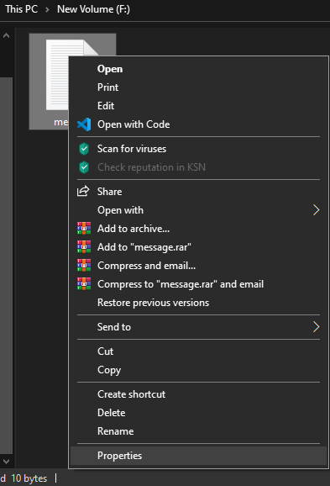
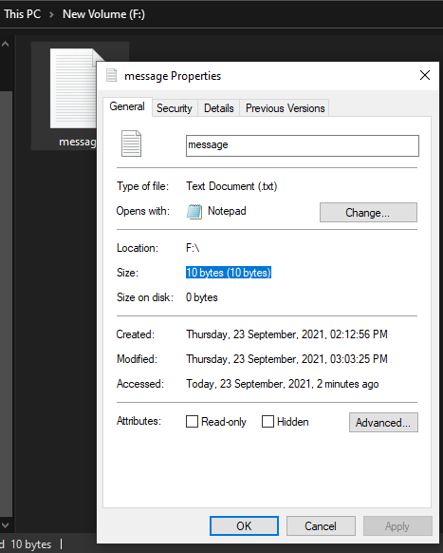
Drawbacks of file handling in Text mode

Slide 7
File Opening Modes
.
Mode | Description
ios :: binary | This mode represents binary mode
connect this object with a file on your hard-disk(pen drive) | It Writes The Data In The File Exactly In The Same Way Like It Is Saved In Ram I.E., In The Form Of 0's And 1’s Due to this we get 2 benefits
write the data | The size of the file is exactly same as the size of the data getting saved
save and close the file | Since the file is in binary format so it can not be read by other people using software like notepad. This makes our file protected

Slide 8
Member Function used for file handling in Binary Mode
For Writing Data in File
First argument represents the address of the variable whose value is to be saved in the file
The second argument represents the number of bytes to be saved in the file.
write(char *, unsigned int)

Slide 9
Member Function used for file handling in Binary Mode
For Reading Data from the File
First argument represents the address of the variable in which the data read from the file is to be saved.
The second argument represents the number of bytes to be read from the file.
read(char *, unsigned int)

Slide 10
The previous code in Binary Mode
Write a program to write an integer value with value 2147483647 in file message.txt
#include <iostream>
#include <fstream>
using namespace std;
int main()
{
fstream fobj;
fobj.open("f:\\message.txt", ios::out|ios::trunc|ios::binary);
int a = 2147483647;
fobj.write((char *)&a, sizeof(a));
fobj.close();
cout<<"File saved successfully!"<<endl;
return 0;
}

Slide 11
Output of The Previous Code
Output
File saved successfully!
Process returned 0 (0x0) execution time : 0.105 s
Press any key to continue.

Slide 12
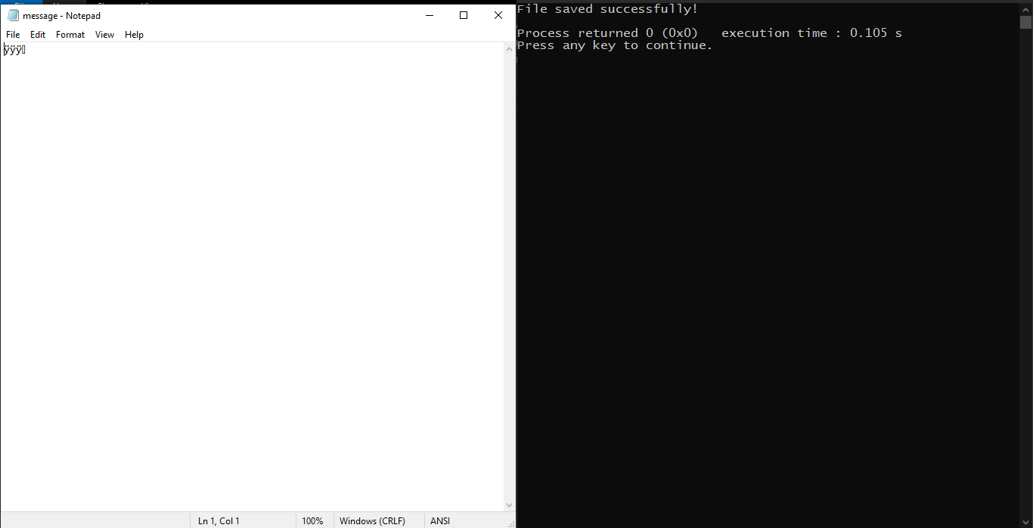
System Screenshot

Slide 13
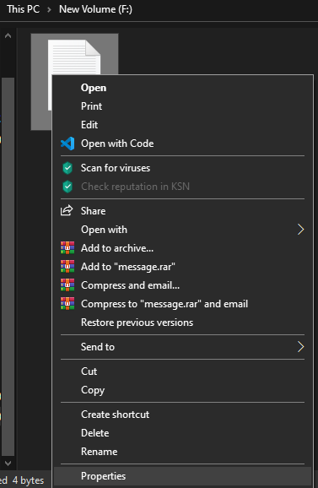
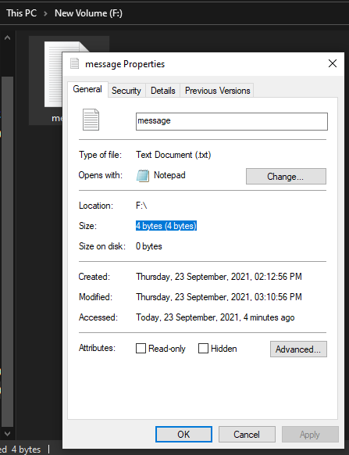
Benefits of file handling in Binary mode

Slide 14
The previous code in Binary Mode for reading from file
#include <iostream>
#include <fstream>
using namespace std;
int main()
{
fstream fobj;
fobj.open("f:\\message.txt", ios::in|ios::binary);
int a;
fobj.read((char *)&a, sizeof(a));
cout<<"Data read from file is: "<<a<<endl;
fobj.close();
cout<<"File saved successfully!"<<endl;
return 0;
}

Slide 15
Output of The Previous Code
Output
Data read from file is: 2147483647
File saved successfully!
Process returned 0 (0x0) execution time : 0.135 s
Press any key to continue.

Slide 16
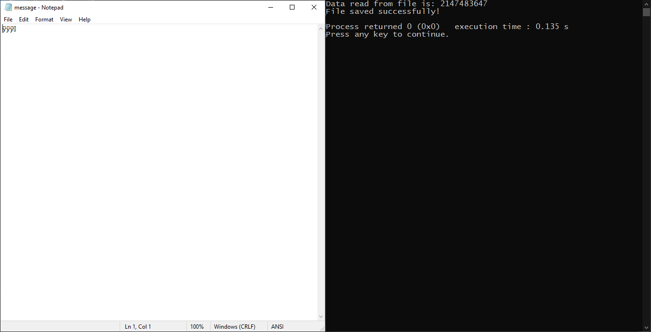
System Screenshot

Slide 17
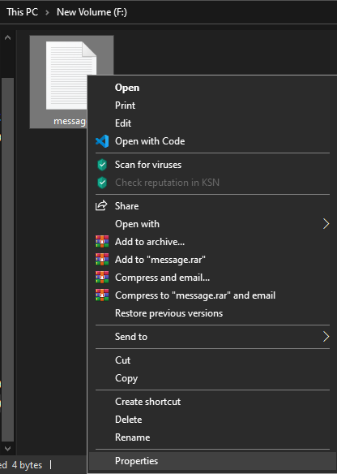
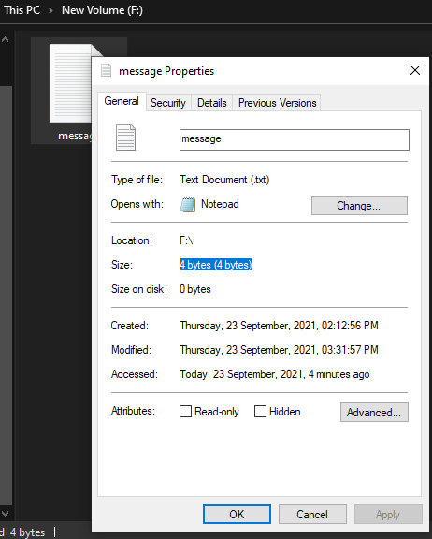
Benefits of file handling in Binary mode

Slide 18
Writing/Reading Objects in File in Binary Mode
#include <iostream>
#include <conio.h>
#include <fstream>
using namespace std;
class Student
{
private:
int roll;
char grade;
float per;
public:
void get()
{
cout<<"Enter roll, grade and per: ";
cin>>roll>>grade>>per;
}
void show()
{
cout<<"roll: "<<roll<<endl;
cout<<"grade: "<<grade<<endl;
cout<<"per: "<<per<<endl;
}
};
int main()
{
fstream fobj;
fobj.open("f:\\records.txt", ios::out|ios::trunc|ios::binary|ios::in);
Student s;
s.get();
fobj.write((char *)&s, sizeof(s));
cout<<"Record saved. Press any key to read it"<<endl;
_getch();
fobj.seekg(0);
Student p;
fobj.read((char *)&p, sizeof(p));
p.show();
fobj.close();
return 0;
}

Slide 19
Output of The Previous Code
Output
Enter roll, grade and per: 101 A 67.8
Record saved. Press any key to read it
roll: 101
grade: A
per: 67.8
Process returned 0 (0x0) execution time : 7.047 s
Press any key to continue.

Slide 20
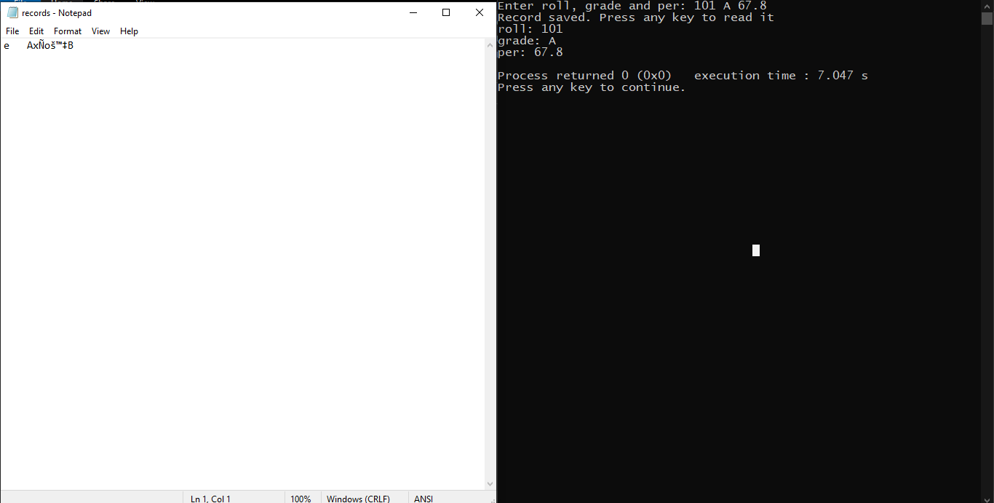
System Screenshot

Slide 21
Assignment
.
Modify the previous code so that you are able to write multiple records in the file and then read them back.
Number of records to be written should be users choice

Slide 22
Writing/Reading Objects in File in Binary Mode
#include <iostream>
#include <conio.h>
#include <fstream>
using namespace std;
class Student
{
private:
int roll;
char grade;
float per;
public:
void get()
{
cout<<"Enter roll, grade and per: ";
cin>>roll>>grade>>per;
}
void show()
{
cout<<"roll: "<<roll<<endl;
cout<<"grade: "<<grade<<endl;
cout<<"per: "<<per<<endl;
}
};
int main()
{
fstream fobj;
fobj.open("f:\\records.txt", ios::out|ios::trunc|ios::binary|ios::in);
Student s;
char choice;
do
{
s.get();
fobj.write((char *)&s, sizeof(s));
cout<<"Any more(y/n/Y/N)?: ";
cin>>choice;
}while(choice == 'y' || choice == 'Y');
cout<<"Record saved. Press any key to read it"<<endl;
_getch();
fobj.seekg(0);
while(1)
{
fobj.read((char *)&s, sizeof(s));
if(fobj.eof())
break;
s.show();
}
fobj.close();
return 0;
}

Slide 23
Output of The Previous Code
Output
Enter roll, grade and per: 101 B 56.3
Any more(y/n/Y/N)?: Y
Enter roll, grade and per: 102 C 45.7
Any more(y/n/Y/N)?: Y
Enter roll, grade and per: 103 A 78.5
Any more(y/n/Y/N)?: N
Record saved. Press any key to read it
roll: 101
grade: B
per: 56.3
roll: 102
grade: C
per: 45.7
roll: 103
grade: A
per: 78.5
Process returned 0 (0x0) execution time : 38.832 s
Press any key to continue.

Slide 24
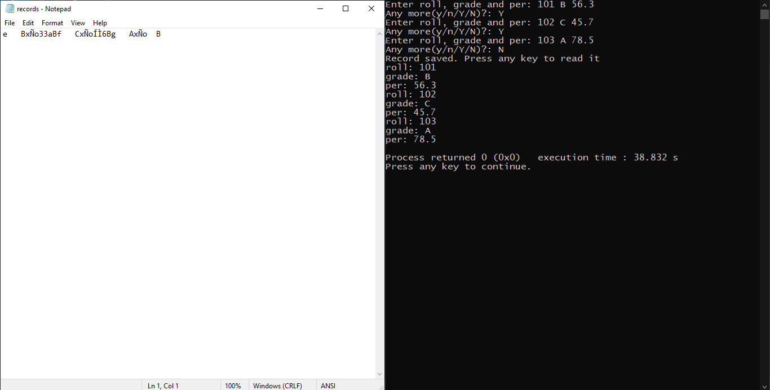
System Screenshot

Slide 25
Assignment
.
Assume you have a file called records.txt in your computer containing several records of students where each records is containing roll, grade and percentage.
Write a program to do the following
1. open the file and read and display it's last record only

Slide 26
Writing/Reading Objects in File in Binary Mode
#include <iostream>
#include <conio.h>
#include <fstream>
using namespace std;
class Student
{
private:
int roll;
char grade;
float per;
public:
void get()
{
cout<<"Enter roll, grade and per: ";
cin>>roll>>grade>>per;
}
void show()
{
cout<<"roll: "<<roll<<endl;
cout<<"grade: "<<grade<<endl;
cout<<"per: "<<per<<endl;
}
};
int main()
{
ifstream fobj;
fobj.open("f:\\records.txt", ios::binary);
Student s;
while(1)
{
fobj.read((char *)&s, sizeof(s));
if(fobj.eof())
break;
}
s.show();
fobj.close();
return 0;
}

Slide 27
Output of The Previous Code
Output
roll: 103
grade: A
per: 78.5
Process returned 0 (0x0) execution time : 0.376 s
Press any key to continue.

Slide 28
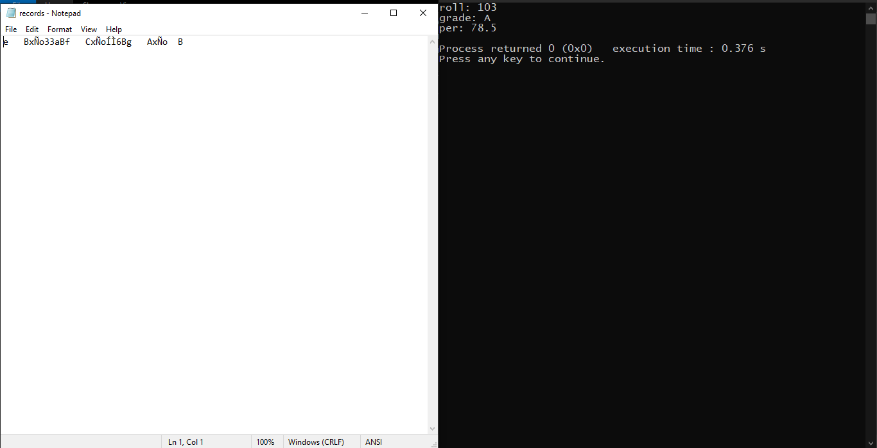
System Screenshot

Slide 29
Optimized version of previous code
#include <iostream>
#include <conio.h>
#include <fstream>
using namespace std;
class Student
{
private:
int roll;
char grade;
float per;
public:
void get()
{
cout<<"Enter roll, grade and per: ";
cin>>roll>>grade>>per;
}
void show()
{
cout<<"roll: "<<roll<<endl;
cout<<"grade: "<<grade<<endl;
cout<<"per: "<<per<<endl;
}
};
int main()
{
ifstream fobj;
fobj.open("f:\\records.txt", ios::binary|ios::in);
Student s;
fobj.seekg(-sizeof(s), ios::end);
fobj.read((char *)&s, sizeof(s));
s.show();
fobj.close();
return 0;
}

Slide 30
Output of The Previous Code
Output
roll: 103
grade: A
per: 78.5
Process returned 0 (0x0) execution time : 0.604 s
Press any key to continue.

Slide 31
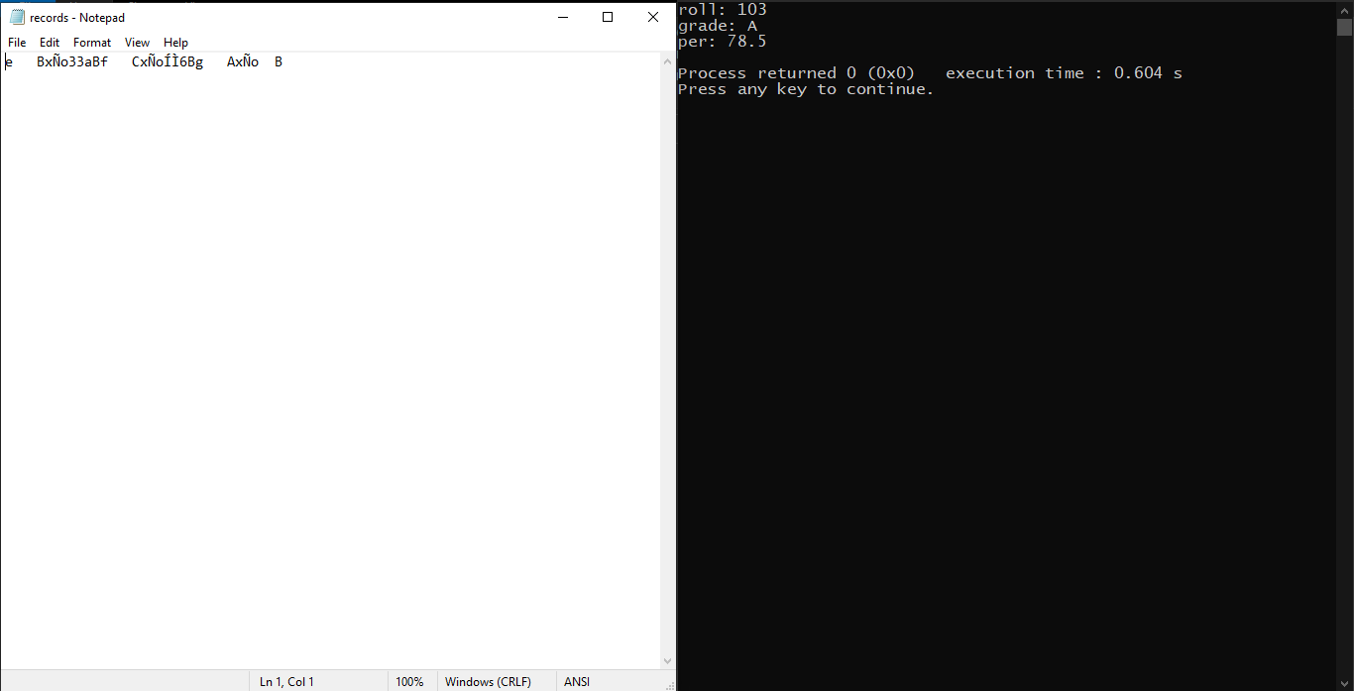
System Screenshot

Slide 32
Assignment
.
Assume you have a file called records.txt in your computer containing several records of students where each records is containing roll, grade and percentage.
Write a program to do the following
2. Ask the user to input a record number and read and display only that record
Make sure if the record number entered is wrong your program should display the message invalid record number

Slide 33
Optimized version of previous code
#include <iostream>
#include <conio.h>
#include <fstream>
using namespace std;
class Student
{
private:
int roll;
char grade;
float per;
public:
void get()
{
cout<<"Enter roll, grade and per: ";
cin>>roll>>grade>>per;
}
void show()
{
cout<<"roll: "<<roll<<endl;
cout<<"grade: "<<grade<<endl;
cout<<"per: "<<per<<endl;
}
};
int main()
{
ifstream fobj;
fobj.open("f:\\records.txt", ios::binary|ios::in);
Student s;
int recno;
cout<<"Enter record no.: ";
cin>>recno;
fobj.seekg((recno - 1) * sizeof(s), ios::beg);
fobj.read((char *)&s, sizeof(s));
s.show();
fobj.close();
return 0;
}

Slide 34
Output - 1
Output
Enter record no.: 3
roll: 103
grade: A
per: 78.5
Process returned 0 (0x0) execution time : 17.525 s
Press any key to continue.

Slide 35
Output - 2
Output
Enter record no.: 1
roll: 101
grade: B
per: 56.3
Process returned 0 (0x0) execution time : 1.518 s
Press any key to continue.

Slide 36
Output - 3
Output
Enter record no.: 2
roll: 102
grade: C
per: 45.7
Process returned 0 (0x0) execution time : 2.475 s
Press any key to continue.

Slide 37
Output - 4
Output
Enter record no.: 10
roll: 0
grade: 0
per: 0
Process returned 0 (0x0) execution time : 4.679 s
Press any key to continue.

Slide 38
Improved version of previous code
#include <iostream>
#include <conio.h>
#include <fstream>
using namespace std;
class Student
{
private:
int roll;
char grade;
float per;
public:
void get()
{
cout<<"Enter roll, grade and per: ";
cin>>roll>>grade>>per;
}
void show()
{
cout<<"roll: "<<roll<<endl;
cout<<"grade: "<<grade<<endl;
cout<<"per: "<<per<<endl;
}
};
int main()
{
ifstream fobj;
fobj.open("f:\\records.txt", ios::binary|ios::in);
Student s;
int recno, count;
fobj.seekg(0, ios::end);
count = fobj.tellg() / sizeof(s);
cout<<"Enter record no.: ";
cin>>recno;
if(recno <= count)
{
fobj.seekg((recno - 1) * sizeof(s), ios::beg);
fobj.read((char *)&s, sizeof(s));
s.show();
}
else
cout<<"Invalid Record number"<<endl;
fobj.close();
return 0;
}

Slide 39
Output - 1
Output
Enter record no.: 3
roll: 103
grade: A
per: 78.5
Process returned 0 (0x0) execution time : 17.525 s
Press any key to continue.

Slide 40
Output - 2
Output
Enter record no.: 1
roll: 101
grade: B
per: 56.3
Process returned 0 (0x0) execution time : 1.518 s
Press any key to continue.

Slide 41
Output - 3
Output
Enter record no.: 2
roll: 102
grade: C
per: 45.7
Process returned 0 (0x0) execution time : 2.475 s
Press any key to continue.

Slide 42
Output - 4
Output
Enter record no.: 15
Invalid Record number
Process returned 0 (0x0) execution time : 1.251 s
Press any key to continue.

Slide 43
End of Lecture P-3
For any queries mail us @: scalive4u@gmail.com
Call us @ : 0755-4271659, 7879165533
Thank you

